Slide 1


ABAP on Hana s/4 Hana Training
Day 16
contact@anubhavtrainings.com

Slide 2

Agenda – Day 16
Hierarchy CDS Programming with Tree Table
New Hierarchy
Classical Hierarchy
Implementation of End to End Hierarchy Scenario
Flow of Employee Manager Hierarchy
Describing Functional Information of Hierarchy

Slide 3
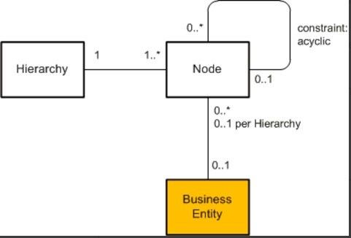
CDS Hierarchy
The CDS view provides a list of hierarchies which is known the hierarchy directory for this node view. Every single node belongs to exactly one hierarchy, which can identified by one or multiple key fields of the node view.
A hierarchy can have multiple root nodes.
Hierarchies allows to traverse data faster
They clearly explain the inter-relation between multiple object
Very helpful determining the parent child relationship

Slide 4
Types of Hierarchy
There are Two types of Hierarchy
Creating Using Annotations
Creating by syntax
CDS Hierarchy
New Hierarchy
Classical Hierarchy

Slide 5
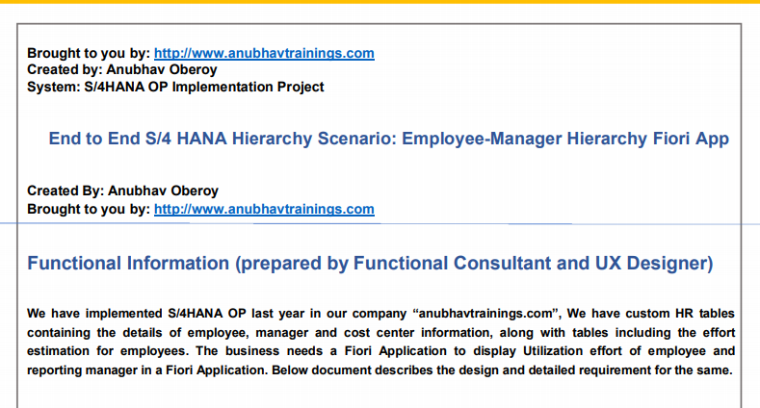
End to End Hierarchy Scenario

Slide 6
Flow of CDS Views in Hierarchy
Consumption CDS View.
Composite CDS View.
Interface CDS View.
Basic CDS View.
ZATS_P_EMPLOYEE
ZATS_I_EMPMGR
ZATS_CO_EMPHOURS
ZATS_C_EMPHOURS

Slide 7
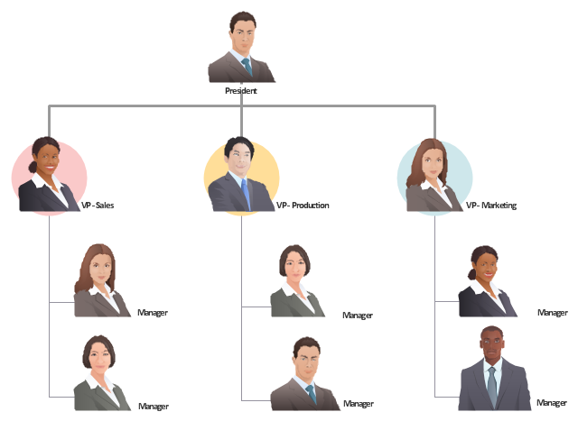
Exercise
CDS Hierarchy Scenario

Slide 8

End of Day 16
Trainer: Anubhav Oberoy

Slide 9

Trainer: Anubhav Oberoy

Slide 10
THANK YOU
If you cannot do
great things, do small things in a great way.
Anubhav Oberoy
https://www.anubhavtrainings.com

Slide 11


We’re committed to empower you to be
Most Desirable Resource
through powerful training solutions.
We build the workforce of the future.
250+
Corporate Clients
30,000+
Learners Trained
25000+
Learners Placed
FREE WEBINARS
Sign up for free webinars with industry experts every fortnight!
Enroll Now!
Contact us today!
https://anubhavtrainings.com/

Slide 12




More from AnubhavTrainings.com

